Slide 1
Algorithmic Trading and High Frequency Finance
FRE-GY- 7251 I – Prof. Pierre Yves Guillo
Rakshit Sareen – rs5606@nyu.edu
Shubhanshu Surana – ss11012@nyu.edu
Dhruv Morzaria – djm697@nyu.edu

Slide 2
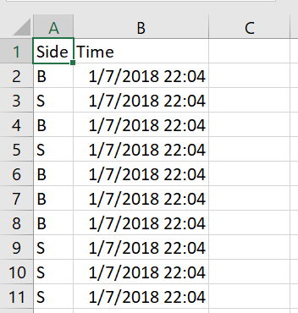
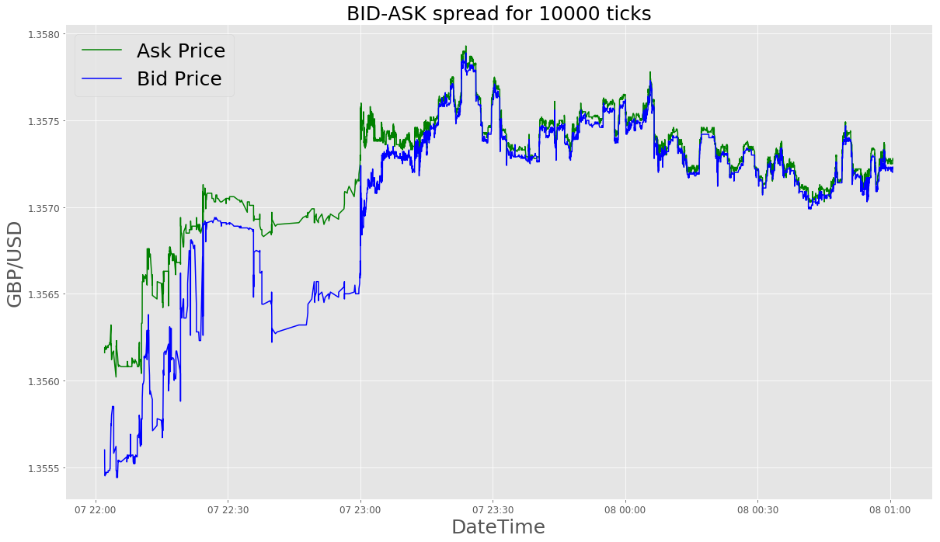
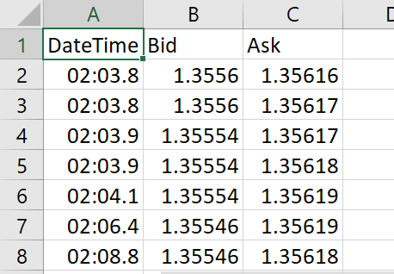
Understanding the Data
Tick Data – Market Ticks
Order Data – From Market Taker perspective
Buy/ Sell Signal & Timestamp of Orders
Market Maker Tick Generation – Upon Market Event
Market Event - Occurrence of Market Tick
- Execution of Order

Slide 3
Approaches to Execution
Passive Approach
Dynamic Approach
1
M Maker assumes role of M Taker.
2
M Maker adjust the bid ask spread to be inside, outside or at market.
3
No PNL and Open Inventory Constraints Applicable.
PNL and Open Inventory Constraints Applicable.
4
No Probability Logic for Order Execution.
Probability Logic for Order Execution.
5
All orders are executed
6
Orders are subject to Probabilities

Slide 4
Constraints and Rules
01
Reaction Time - Reaction time-10msec
02
Open Position Limit +/-8mm
03
Execution Probability and Follow-up Probability
04
Laying off Risk

Slide 5
Implementation Flow
Performance Stats
Mean PNL
Median PNL
25 and 75% tile PNL
Cumulative PNL
Information Ratio
Win-Loss Ratio
.
Plot Graphs
Traverse through tick data
Calculate MM Bid-Ask Spread
Compare M and MM Bid-Ask Time Series
Plot Open Inventory Positions and Cumulative PNL Graphs.
Finding MM Tick
Execute order by offering a price, which can be inside, outside or at the market price based on probabilities
Adding a time delta of 10msec to Market tick or on occurrence of an order.
Step 1
Step 2
Step 3
Step 4
Step 5

Slide 6
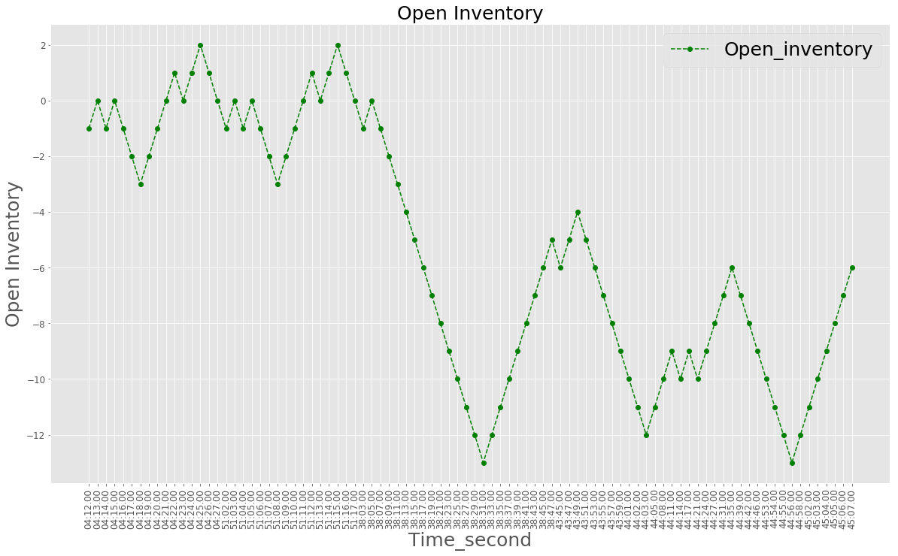
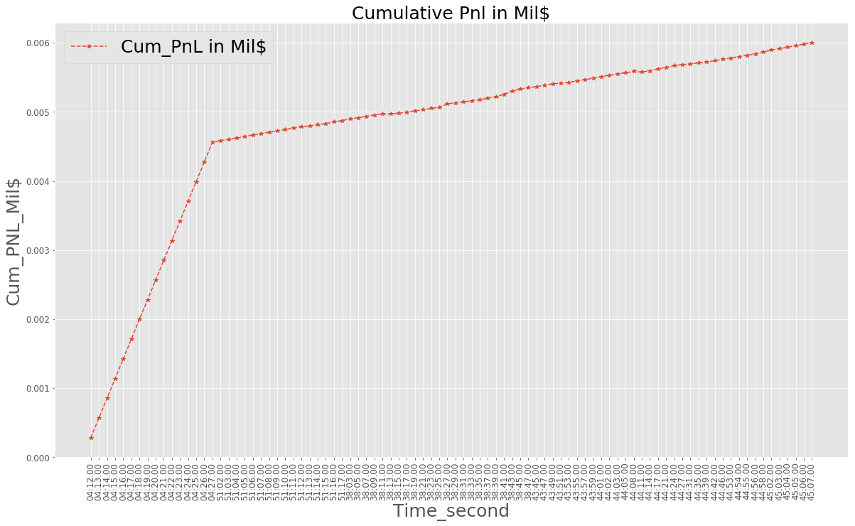
Passive Approach
Open Inventory
Cumulative PNL

Slide 7
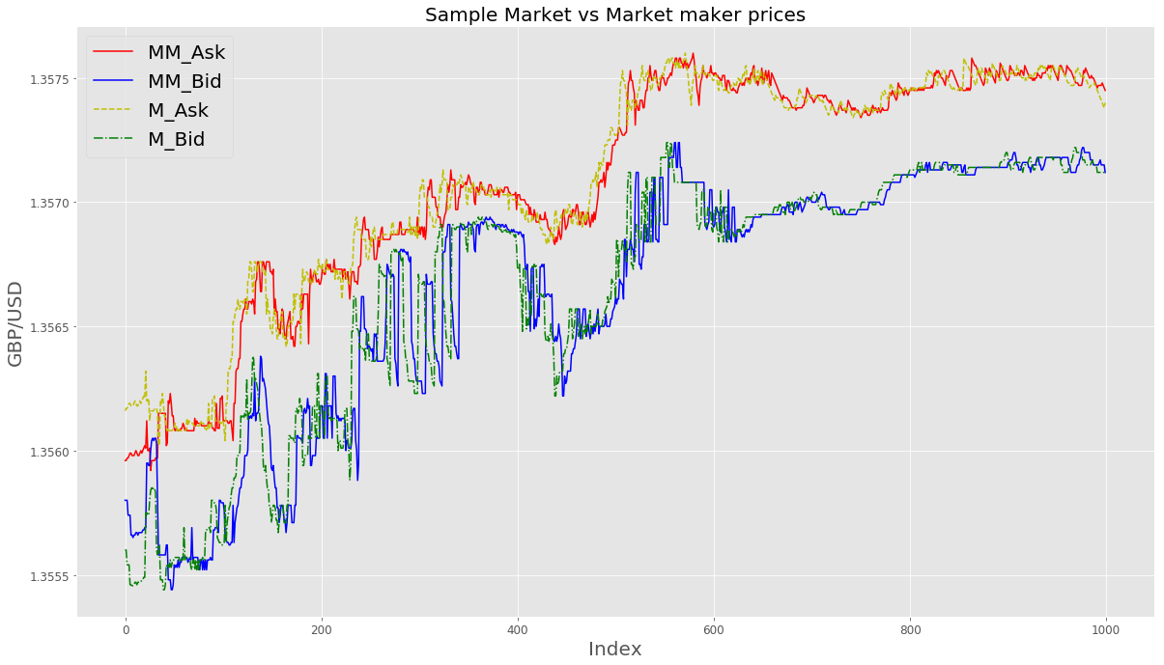
Dynamic Approach
Maker Bid Ask
Market Making Bid Ask

Slide 8
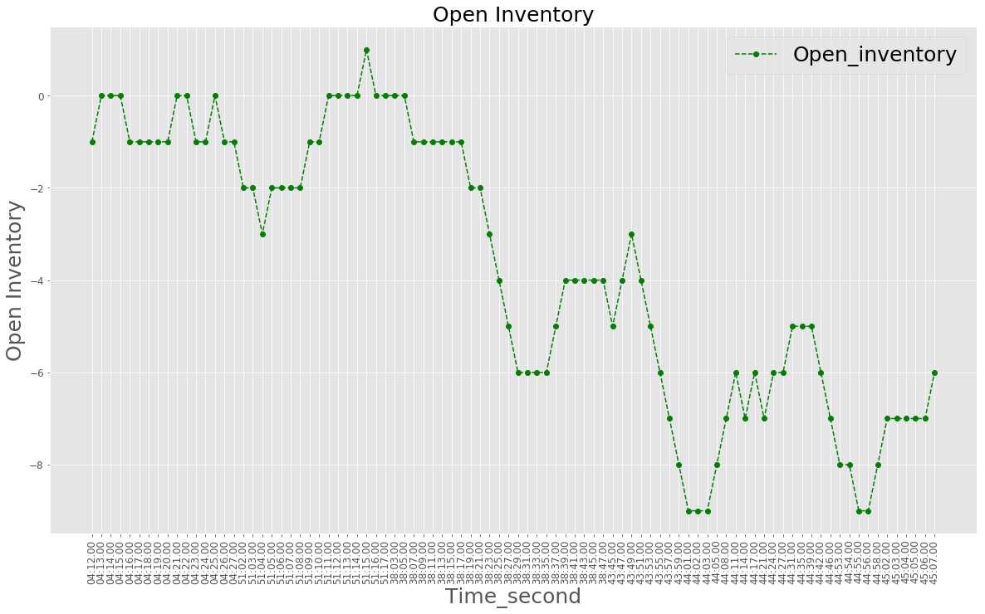
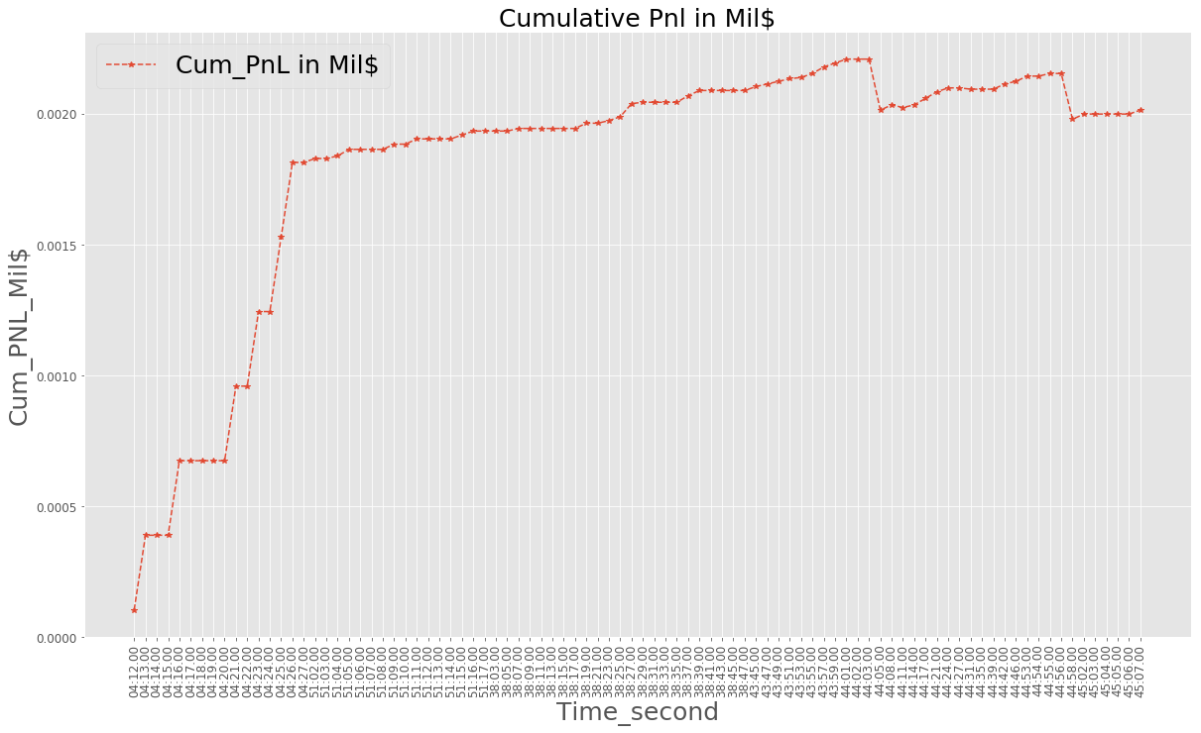
Dynamic Approach
Open Inventory
Cumulative PNL

Slide 9
Performance of two approaches
Approach 1 – Passive Approach Statistics Approach 2 – Dynamic Approach
Statistics | Values
Mean PNL | 43.8
Median PNL | 3
Volatility | 0.08
25%tile | 10
75%tile | 25
Information Ratio | 2.43
Execution % | 51.0%
Win-Loss Ratio | 10.5
Statistics | Values
Mean PNL | 66.72
Median PNL | 20
Volatility | 0.08
25%tile | 15
75%tile | 25
BUY
SELL

Slide 10
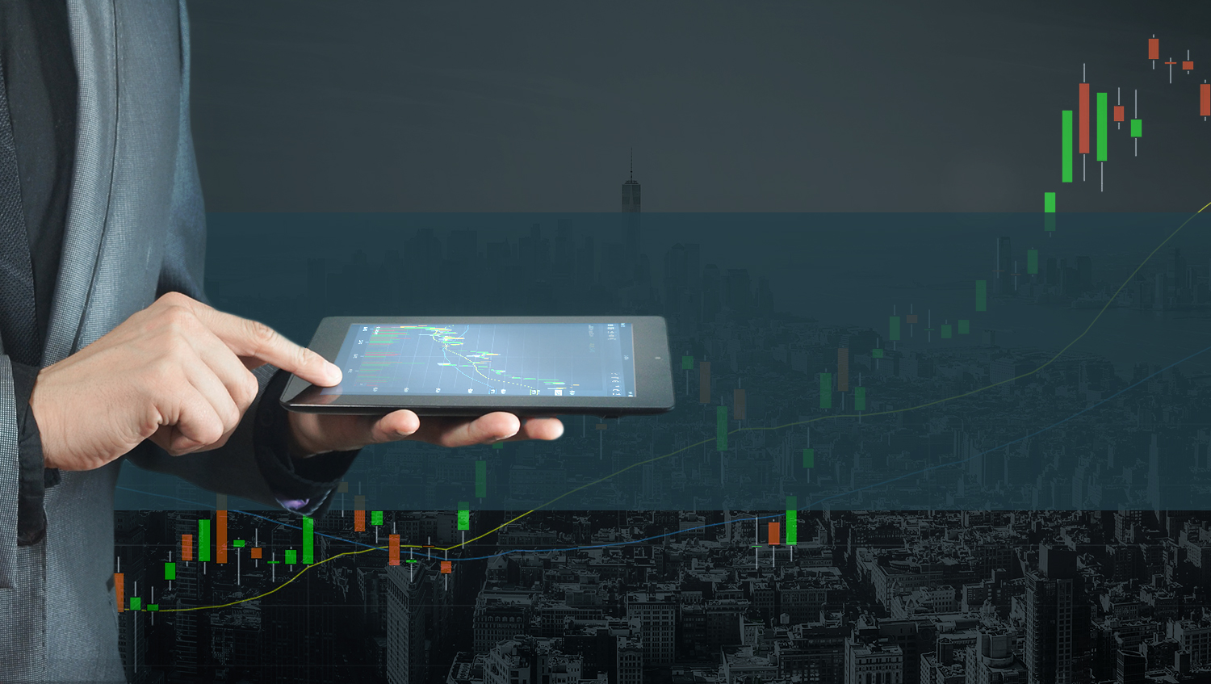
Thank You

